Slide 1




Sponsored by

Slide 2
A 50 Year History of Safety Awareness in the US Gulf of Mexico
And
Lessons for the Future
by
Kenneth E. (KEN) Arnold, PE, NAE
Senior Technical Advisor
WorleyParsons
November, 2015

Slide 3
Outline
Introduction
The Regulators
In The Beginning- 1964 to 1969
The Awakening- 1969 to 1970
Compliance Mentality- 1971 to 1988
Process Safety Management- 1988 to 2010
Safety Culture- 2010 to Present
Avoiding the Maginot Line
Conclusion

Slide 4
Introduction
Safety Awareness
  No one wants to risk his life
  No one wants to cause the death of others
  No one wants to injure others
  No one wants to destroy the environment
Awareness of what to do and what is possible changes with time
  Slow improvement
  Major advances after accidents
  Threat of regulations

Slide 5
Outline
Introduction
The Regulators
In The Beginning- 1964 to 1969
The Awakening- 1969 to 1970
Compliance Mentality- 1971 to 1988
Process Safety Management- 1988 to 2010
Safety Culture- 2010 to Present
Avoiding the Maginot Line
Conclusion

Slide 6
Department of Interior (DOI)
BSEE
Primary responsibility for operational safety regulations
Name changes but function consistent
  Conservation Division of US Geologic Survey (USGS)
  Minerals Management Service (MMS)- 1982
  Bureau of Safety and Environmental Enforcement (BSEE)- 2011
Core Group of Dedicated Professionals
  Challenged us to reflect best safety theories of time
  Recognized need to adopt new technical realities
  Listened to industry for practicality

Slide 7
Bureau of Interior
BOEM
Bureau of Offshore Energy Management
  Split MMS into BSEE and BOEM in 2011
  Perceived need to separate promoting development and scientific and resource management from safety
BOEM responsibilities
  Manage lease sales, resource evaluations, environmental studies, fair market determinations, geological and geophysical permits
  Review exploration plans and development plans
Perception vs. Reality
  Coordination challenges
  Inefficiencies and delays

Slide 8
US Coast Guard (USCG)
Focus on safety of life at sea
  Fixed Platforms: fire-fighting, emergency lighting, escape and abandonment
  Floating Installations: hull integrity, ballast control, marine systems and manning
2002 MOU
  MMS authorized to perform USCG annual inspections on fixed platforms
2008 MOA
  Matrix defines split between MMS and USCG for floaters
  Some shared responsibilities; inefficiencies and delays

Slide 9
Pipeline and Hazardous Materials Safety Administration (PHMSA)
Department of Transportation (DOT)
Pipelines downstream of sales point (where operating responsibility transfers from producing company to pipeline company)
MMS has responsibilities for pipelines upstream of this point
MOU
  MMS gives ROW permits for DOT pipelines
  MMS inspects DOT pipelines

Slide 10
Environmental Protection Agency (EPA)
1970 USGS set oil and grease (50/100 ppm)
EPA Established in 1970
1975 EPA given control over produced water discharges
1989 MOA gave inspection responsibilities to MMS

Slide 11
Outline
Introduction
The Regulators
In The Beginning- 1964 to 1969
The Awakening- 1969 to 1970
Compliance Mentality- 1971 to 1988
Process Safety Management- 1988 to 2010
Safety Culture- 2010 to Present
Avoiding the Maginot Line
Conclusion

Slide 12
Public Radar (1964-1969)
From 1964 to 1969 safety was NOT on the public radar
1962 Rachael Carson’s “Silent Spring”
1967 Environmental Defense Fund
1970 EPA
1971 OSHA

Slide 13
Attitudes (1964-1969)
“We work and live offshore; it is our lives at stake. And we are avid fisherman and hunters. We want to assure safety and protect the environment as much as anyone.”
Accidents will happen, fingers were expendable
1965 Safety Inspection Example
Construction Safety Examples

Slide 14
OCS Orders (1964-1969)
1958-1960 Orders 1 to 5
  Drilling, P&A, Producibility, Storm Chokes
  No standards or test requirements
12 People in USGC Gulf Coast Region, 1500 platforms
  Waivers freely granted
No limitation on produced water discharges
  Burn pits in marsh
  Flow from FWKO overboard

Slide 15
Outline
Introduction
The Regulators
In The Beginning- 1964 to 1969
The Awakening- 1969 to 1970
Compliance Mentality- 1971 to 1988
Process Safety Management- 1988 to 2010
Safety Culture- 2010 to Present
Avoiding the Maginot Line
Conclusion

Slide 16
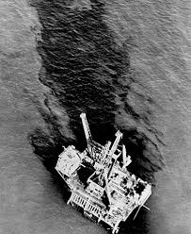
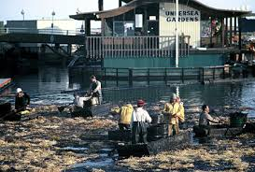
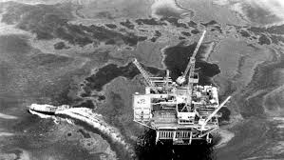
Unocal Santa Barbara- 1969
No surface casing
Well swabbed-in
Blowout
Blind rams closed
Flow outside of conductor
80,000 to 100,000 barrel spill

Slide 17
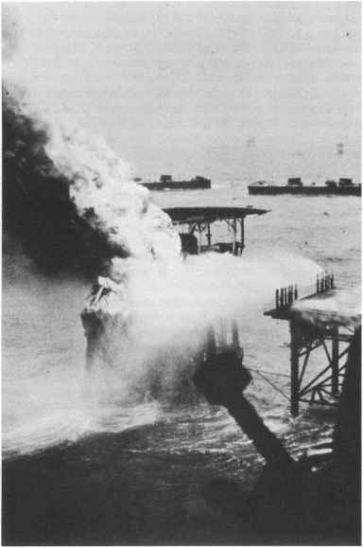
Chevron MP 35 Fire- 1970
Fire started 30 minutes after platform left unattended
8 wells on fire
Controlled by relief wells, explosives and capping, shooting off wing valve
35,000 to 65,000 barrels spilled

Slide 18
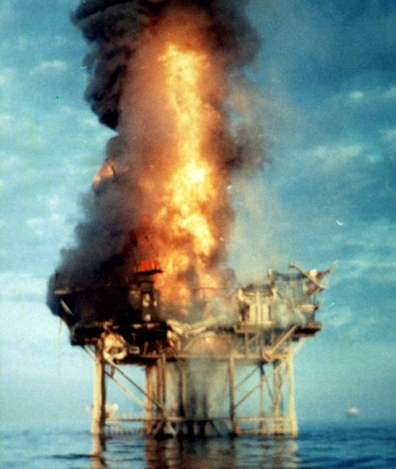
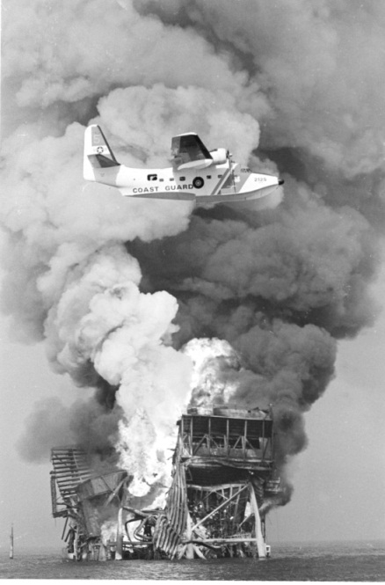
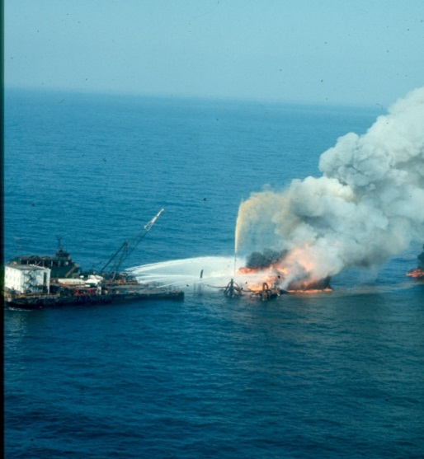
Shell Bay Marchand
Block 2
Simultaneous ops- drilling, production, workover
4 Killed
11 Wells Blowing -out
Some bridged, some relief wells, shooting off wing valve

Slide 19
Regulatory Action (1969-1970)
Revised OCS Orders 1 to 5
Order 6 Completion of Oil and Gas Wells
  Pressure rated and tested wellhead
  Casing pressure tested and monitored
Order 7 Pollution and Waste Disposal
  Leasee obligation to pay for cleanup
  Reporting of spills
Order 8 Platforms and Structures
  Requirements for wellheads (automatic shut-in valves), flowlines (check valves), pressure vessels (high and low pressure and level sensors, relief valves), gas detectors, firefighting equipment, drip pans, etc.
Order 9 Pipelines
  Requirements for pipeline design, shut-in valves and check valves.

Slide 20
Industry Response (1969-1970)
Initially fought Orders 8 & 9 and need for something better than storm chokes
  Problems with sensor reliability
  Hazardous to install on equipment not designed for them
  Hazards with frequent shut-ins greater than benefit of new devices
OOC formed Technical Sub-Committee to improve design and sensor safety
  Industry decided to make the sensors and safety valves more reliable

Slide 21
Outline
Introduction
The Regulators
In The Beginning- 1964 to 1969
The Awakening- 1969 to 1970
Compliance Mentality- 1971 to 1988
Process Safety Management- 1988 to 2010
Safety Culture- 2010 to Present
Avoiding the Maginot Line
Conclusion

Slide 22
Equipment and System Design
(1971-1988)
1972 API OSAPE formed
  OOC Technical Subcommittee for oversight
  USGS active representation
1972 Order 5 revised to require SCSSVs
1975 OSAPE Standards and Recommended Practices
  14A&B SCSSV
  14C process sensors and shutdowns
  14E piping systems
  14F electrical systems
  14G fire fighting systems
Great example of MMS, OOC, API and service companies working together for safety

Slide 23
Personnel Safety (1971-1988)
1971 OSHA puts pressure USGS to emphasize safety, health and welfare of individual workers
  Walking and working surfaces
  Dropped objects
  Noise
  Hazardous materials handling
  Use or misuse of tools
  Personal protective equipment
Heinrich Triangle

Slide 24
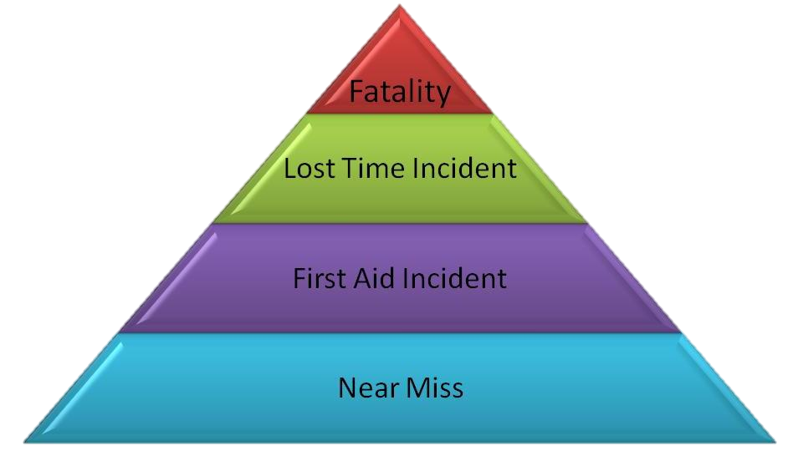
Heinrich Triangle- 1931
Greater attention to “slips, trips and falls”
Companies paid attention; staff noticed and acted differently
IADC: Worldwide LTI dropped 70% from 1969 to 1988

Slide 25
Produced Water Discharge
1974 OOC 38 Platform Study
  Eliminated highest 10% of data and all platforms averaging over 100 ppm
  100 ppm was 98th Percentile of 1218 data points
  Anything less than 50/100 ppm will cause loss of production
1975 EPA 48/72 mg/l
  No production loss
1993 EPA 29/42 mg/l
  OOC predicted massive production loss
  No production loss
2015 some operators self impose 15 mg/l
  29 mg/l = 0.3% of O&G discharged by Mississippi
  Are we crazy?

Slide 26
Outline
Introduction
The Regulators
In The Beginning- 1964 to 1969
The Awakening- 1969 to 1970
Compliance Mentality- 1969 to 1988
Process Safety Management- 1988 to 2010
Safety Culture- 2010 to Present
Avoiding the Maginot Line
Conclusion

Slide 27
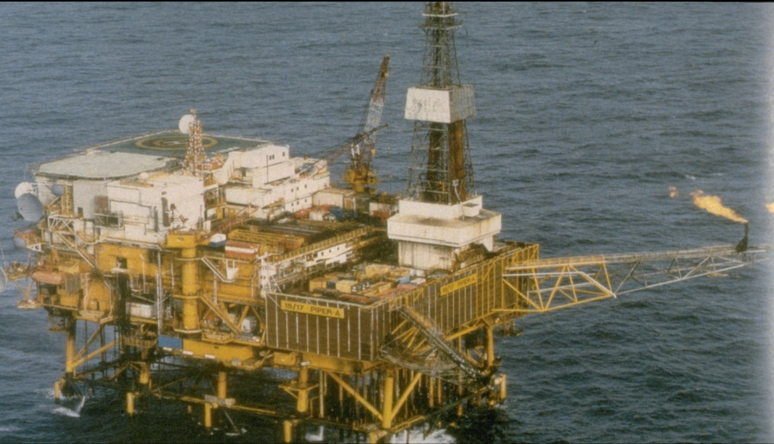
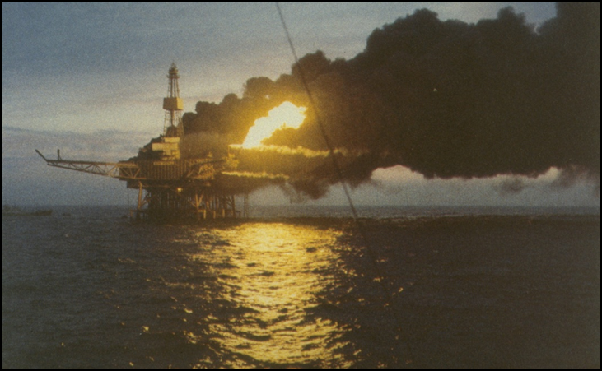
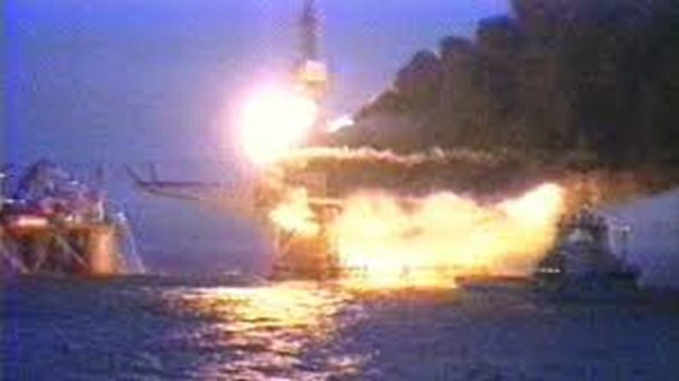
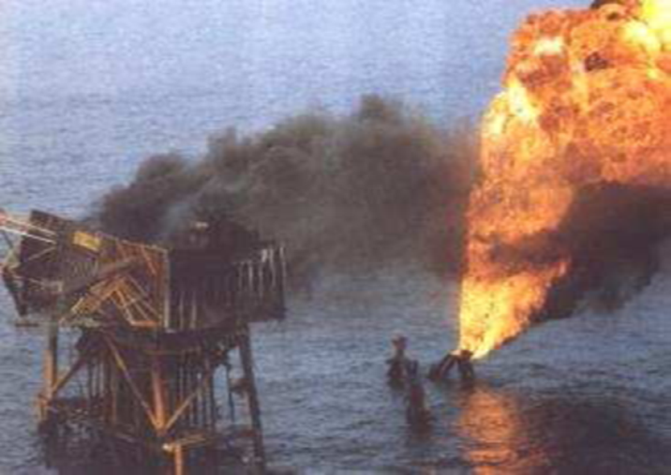
Piper Alpha (1988)

Slide 28
Piper Alpha (1988)
167 Deaths
Total loss of platform
Failure of SMS:
  Permit to Work
  Lockout-Tagout
  Safety Audits
  Operating Procedures
  Abandon Platform Procedures

Slide 29
Process Safety Management- PSM
(1988-2010)
1990 Marine Board Report on Inspection Alternatives
  Attitude of compliance
  “Majority of accident events occurring on the OCS are related to operational and maintenance procedures or human error that are not addressed directly by the hardware-oriented PINC list”
1992 OSHA publishes PSM rule
  Goal setting: manage safety like any other activity
1993 API RP 75 SEMP and RP 14J Design and Hazards Analysis
  Applies only to OCS
  “We don’t want to be forced to live with this in other locations.”

Slide 30
Management Principles |  | Elements
Planning |  | Employee Participation Process Safety Information (PSI) Hazards Analysis (HA) Pre-Startup Safety Review Emergency Planning and Response
Organizing |  | Operating Procedures Safe Work Practices Training
Implementing |  | Contractor Safety Mechanical Integrity Management of Change
Evaluating |  | Incident Investigation Compliance Audits
SEMP Elements
Grouped According
to
Management Principles
Notes:
30

Slide 31
SEMP (1988-2010)
1994 rule making started and concept embraced by OOC and API
  Training workshops
  Model SEMP developed (DOE funded)
1995 rule making stopped and compliance made voluntary
  Contract with America
  Lobbying by small operators
  MMS Regions oppose goal setting
    Want prescribe, approve and inspect culture
Some operators incorporate elements in SMS

Slide 32
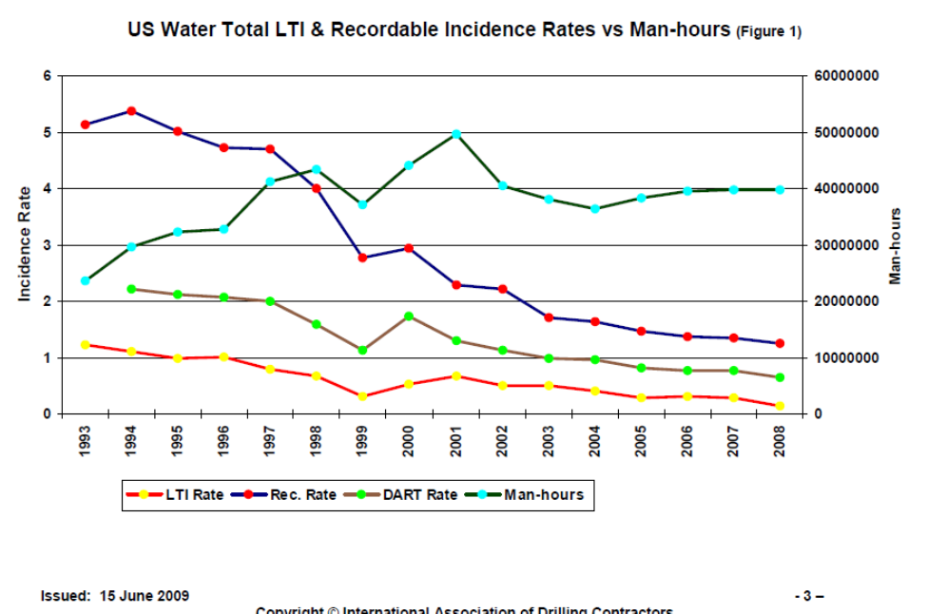
Back to Personnel Safety and Compliance Mentality
Year | Loss of Well Control | Fatalities | Explosions
1991 | 6 | 2 | 1
1992 | 1 | 4 | 0
1993 | 2 | 1 | 1
1994 | 0 | 6 | 1
1995 | 1 | 8 | 0
1996 | 4 | 10 | 8
1997 | 5 | 8 | 9
1998 | 7 | 14 | 4
1999 | 5 | 5 | 7
2000 | 9 | 5 | 2
2001 | 9 | 7 | 6
2002 | 6 | 6 | 3
2003 | 5 | 10 | 6
2004 | 4 | 3 | 4
2005 | 4 | 5 | 2
2006 | 2 | 10 | 0
2007 | 7 | 5 | +
2008 | 8 | 11 | +
2009 | 6 | 4 | +
GOM Loss of Well Control, Fatalities, Explosions (BSEE)
+ Indicates Explosions no longer reported separately

Slide 33
SEMS (1988-2010)
2006 MMS started promulgating SEMP as a regulation
  OOC: Not needed
2009 MMS identified 4 Elements caused majority of accidents
  Proposed making HA, MOC, OP, MI mandatory
  OOC: Not needed but if you insist make it all mandatory
2010 final rule prepared and ready for promulgation

Slide 34
Outline
Introduction
The Regulators
In The Beginning- 1964 to 1969
The Awakening- 1969 to 1970
Compliance Mentality- 1971 to 1988
Process Safety Management- 1988 to 2010
Safety Culture- 2010 to Present
Avoiding the Maginot Line
Conclusion

Slide 35
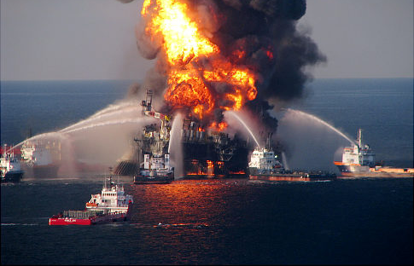
Macondo Blowout
20 April 2010
11 Deaths
Worst oil pollution in US history
Causes:
  Misinterpretation of cement test
  Failure to monitor flow in and out of well
  Slow response to activate rams
  Testing of BOP

Slide 36
30-Day Interim Report
April 30 Secretary of Interior charge by President to report on actions to improve safety
IADC and API Joint Industry Task Force
  Technical, operational and regulatory
  Most adopted in Interim Report
  Most adopted by regulation
Even before we knew the precise cause we knew what needed to be done

Slide 37
Public Reaction (2010-Present)
New rules for well drilling, cementing and design and testing of blowout preventers
SEMS mandatory
  Industry blamed for rejecting SEMS
A call for major change in the industry’s “Culture of Safety”
BSEE and industry beginning to focus on Safety Culture in Operations
  Formation of the Center for Offshore Safety
  Formation of the Offshore Energy Safety Institute

Slide 38
Culture of Safety
From an organizational perspective there must be:
  Mechanisms Establishing Structure and Control - specify what is needed and check that it is being done
  Actions Establishing Safety Norms - encourage the application of Safety Culture traits
From an individual perspective there must be:
  Mechanisms Establishing Competency – knowledge of the structure, control and norms, and ability to perform
  Actions Establishing Motivation - showing that individuals actually act in accordance with behavioral norms

Slide 39
SEMS and Safety Culture
A properly functioning SEMS addresses the “mechanism” elements necessary to create a culture of safety
  Organization – a structure and system of controls
  Individual – training and competency
SEMS does not address the “action” elements
  Organization – actions establishing behavioral norms
  Individual – actions proving motivation
SEMS is a “necessary” but not “sufficient” element in creating a culture of safety

Slide 40
Center for Offshore Safety
Guidelines and Protocols for
  Auditing SEMS
  Certifying SEMS auditors
  Instructing supervisors and executives on field visits
Clearing house for sharing information
Problems
  Independent but organized by API
  Not seem by outsiders as independent of API lobbying
  Dues structure makes membership problematic for all but large operators and contractors

Slide 41
Offshore Energy Safety Institute
Organized and funded (in part) by BSEE
Partnership of Texas A&M, University of Texas and University of Houston
Mission:
  Provide forum for dialogue, shared learning and cooperative research among academia, government, industry and NGOs
  Gather data and inform BSEE on technological and other developments within the offshore industry
  Provide technological education and training of BSEE and BOEM employees

Slide 42
Outline
Introduction
The Regulators
In The Beginning- 1964 to 1969
The Awakening- 1969 to 1970
Compliance Mentality- 1971 to 1988
Process Safety Management- 1988 to 2010
Safety Culture- 2010 to Present
Avoiding the Maginot Line
Conclusion

Slide 43
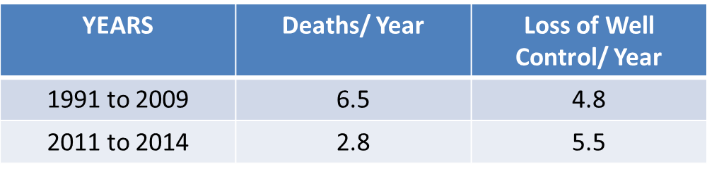
Progress Since 1964
Standards for equipment and system design
Focus on personnel safety
Safety Management Systems
Human Factors and Safety Culture

Slide 44
Six Things I Worry About
Compliance Attitudes
Punish the Bad Guys Mentality
SEMS Reality
Safety Culture
Imagining the Impossible
Training the Next Generation

Slide 45
Compliance Attitudes
~ 80 independent operators
Many believe safety means complying to regulations and passing inspections
BSEE Regions and Districts want PINC Lists
SEMP/ SEMS meant to be goal setting
  OOC: what paperwork is necessary to pass an inspection
  BSEE: looking for pass/fail
  Requires subjective judgement to measure effectiveness
BSEE has to lead by changing its mentality
  TRB Report 309, “Evaluating the Effectiveness of Offshore Safety and Environmental Management Systems”

Slide 46
Punish the Bad Guys Mentality
All will be good if we can just identify the bad guys who cause accidents and punish them with INCs and penalties
Punishment for willful violations is important
Punishment for paperwork failure does not change attitudes
Penalties and punishment get attention but so do accidents
OESI should focus on:
  Educating BSEE personnel
  Develop practices for BSEE to hire auditors
  Focus on soft skill concepts to help BSEE and industry work together to change behaviors

Slide 47
SEMS Reality
Audits which do NOT find areas that need improvements are not proper audits
Quality of audits submitted to BSEE vary widely
  BSEE should be distributing lessons learned
Restructure COS
  Free from API
  Membership free and required
  Support with fee on oil and gas produced
  Work closely with BSEE to distribute lessons learned

Slide 48
Safety Culture
Industry in general is still looking towards:
  Pronouncements
  HSE Department safety slogans and campaigns
  Policies and procedures
Result of actions by supervisors at EVERY level of organization
Traits of Culture of Safety:
  Leadership communication
  Problem identification and resolution
  Acceptance of personal accountability
  Planning and control of work practices
  Continuous learning
  Freedom to raise concerns
Restructured COS using techniques developed by OESI

Slide 49
Imagining the Impossible
Before Piper Alpha no one imagined such an accident was possible in a producing operation
Before Macondo no one imagined such an accident was possible in temporarily abandoning a well
In hindsight we always see clues which indicated a problem could arise
  30 Day Interim Report
The next accident will probably not mirror Piper Alpha or Macondo
  Riser parts prior to the boarding valve
Do we need a forum to anticipate how to anticipate the impossible and respond to it BEFORE it occurs?

Slide 50
Training the Next Generation
Relying on policies, procedures and stage gates
Oil Company - History
  Multiple assignments in field locations and engineering groups
  In-house training programs
  Real mentor as supervisor
Engineering Company - History
  Oil company trained engineers
  Construction company trained engineers
Today
  Training budgets cut
  Limited ability for field experience
Oil companies need to allow
  Billable hours for training
  Visits to field and construction sites

Slide 51
Outline
Introduction
The Regulators
In The Beginning- 1964 to 1969
The Awakening- 1969 to 1970
Compliance Mentality- 1971 to 1988
Process Safety Management- 1988 to 2010
Safety Culture- 2010 to Present
Avoiding the Maginot Line
Conclusion

Slide 52
The history of safety awareness in the past 50 years is actually a good story. Yes, we have tended to make step changes in safety only after disasters or threats of regulations. Our record is spotty and at times as an industry we fought change that we now know we should not have done. But we have made tremendous changes in safety while at the same time we have taken on ever more difficult and risky operations to provide the world with the energy it needs.
Within the industry there was never a time when we lacked leadership to push safety awareness to higher levels. We have made mistakes, but we have learned how to be better along the way.
We have had regulators who are dedicated to the task and have helped us achieve results. They have not been perfect, but neither have we.
This is a fraternity I am honored and proud to be among.

Slide 53
ken.arnold@worleyparsons.com
+1 832-335-6715

